Slide 1
Tableau Homework - Citi Bike Analytics
Ken Ho
Nov 23, 2020

Slide 2
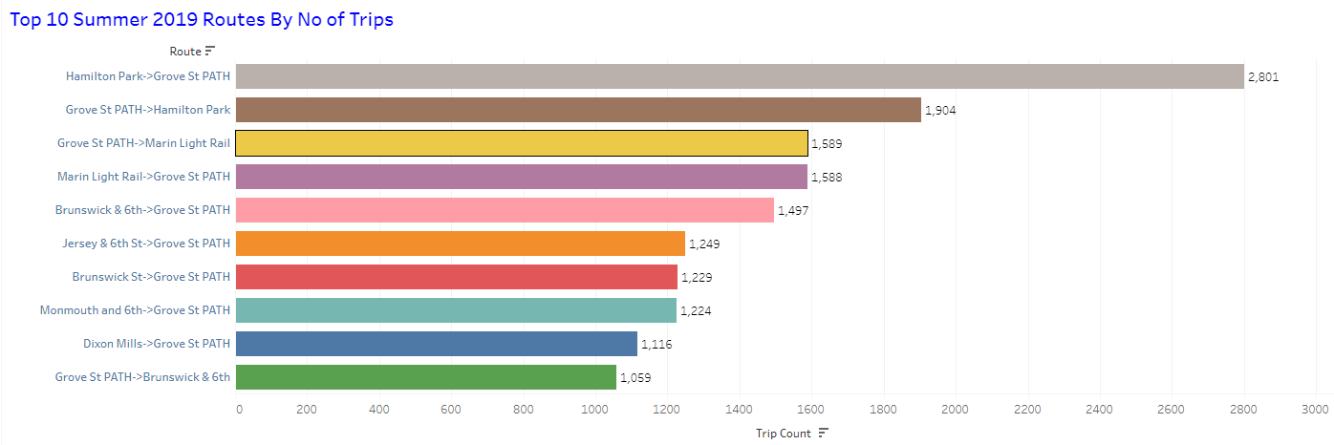
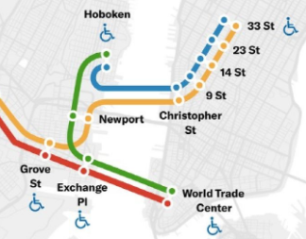
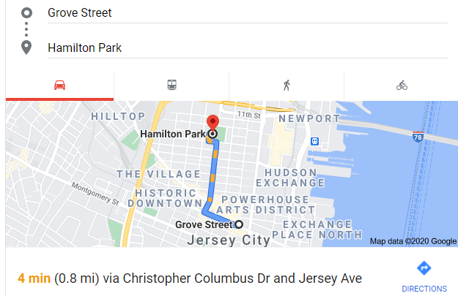
The top 10 routes based on the number of trips are shown above. Compared to the tenth, the highest station has about 1,742 more trips or 20 trips per day
Our data shows that the top two routes are the Hamilton Park to Grove Street PATH Station and return trip. These two stations are about 0.8 miles from each other in Jersey City. The PATH Train from Grove Street is on a popular commute route to the World Trade Center in New York City. Grove Street PATH also runs on another line up north to New York City’s 33rd Street Station. This is the Fashion District and also where Macy’s is located. From here, it is a short walk to New York City’s Penn Station where the Long Island Railroad originates. A 15-minute walk further north is Grand Central Station, another critical commuter hub. These are why the two routes are the top ones for Citi bikes in Jersey City
The top two routes of Hamilton Park and Grove Street PATH Station also has the largest number of bicycle docks (12 each) and hence bicycle availability in the neighborhood

Slide 3
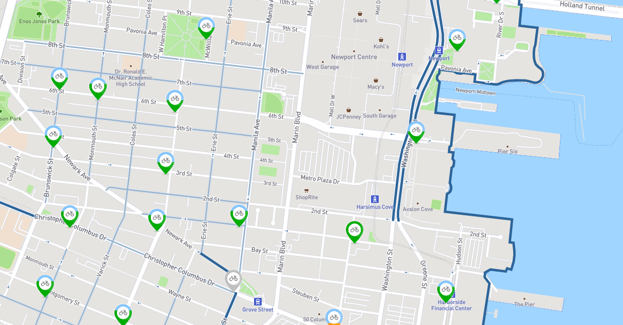
Brunswick & 6th
Hamilton Park
Jersey City, NJ
All of the top 10 routes have Grove Street PATH Station as either a starting or ending station
Bottom stations such as Brunswick & 6th are further away from the major commuting hub such as Grove Street PATH Station and they are also in less populated and busy neighborhoods. Additionally they also has the least number of docks and hence bicycles available
The top 10 routes are located around the Jersey City area

Slide 4
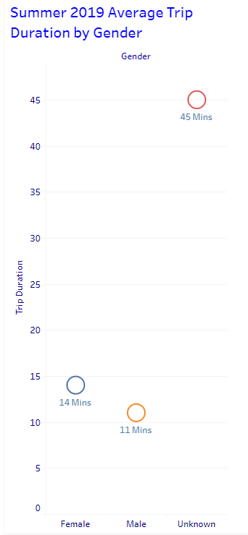

The average bicycle trip duration of males are 11 minutes while that of females are 14 minutes
An unexpected phenomena is the unknown gender having the highest average trip duration of 45 minutes

Slide 5
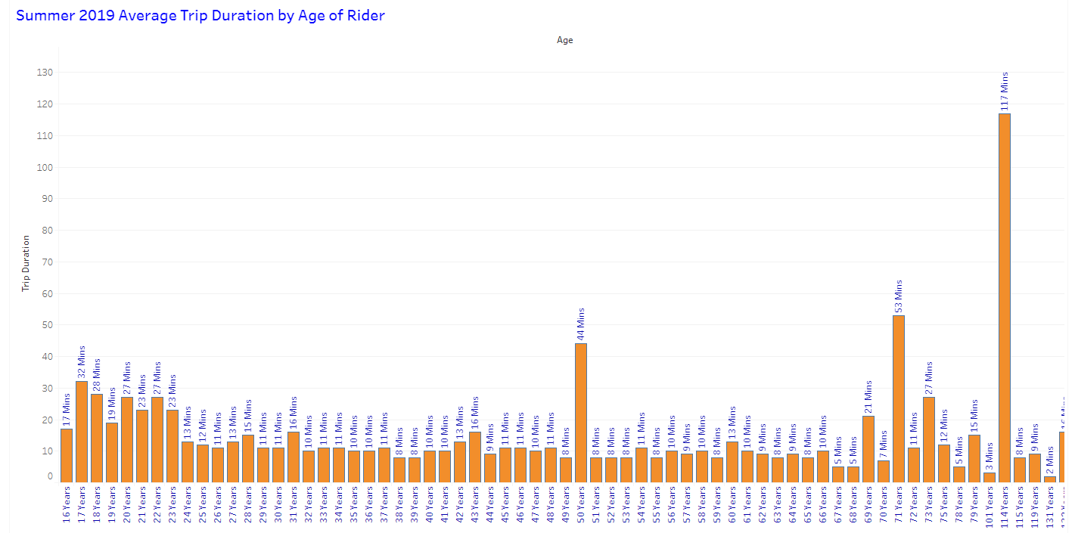
remove from analysis
outlier; unexpected phenomena
outlier; unexpected phenomena

Slide 6
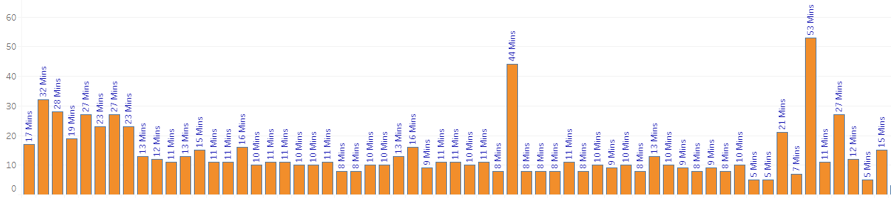
outlier; unexpected phenomena
outlier; unexpected phenomena
17 to 23
24 to 37
38 to 48
49 to 68
Age group of 16 years has an average trip duration of 17 minutes
The age group of 17 to 23 years has an average trip duration of 26 minutes
As the age increase beyond 23, the average trip duration seem to decrease with age increase
The age group of 23 to 37 years has an average trip duration of 12 minutes
We measured an average trip duration of 10 minutes for the age group of 38 to 48 years
The age group of 49 to 68 years has an average trip duration of 8 minutes

Slide 7
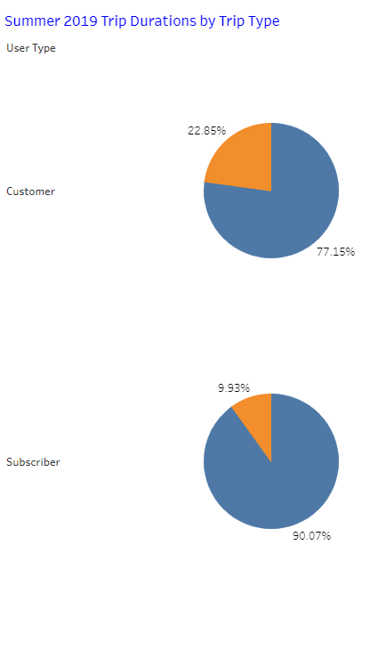

Subscribers are those who join the Citi bike membership and use the bicycles more frequently for all kinds of purposes. Therefore, they are less likely than Customers to return the bicycles to the same stations
Customers use the bicycles less frequently and usually need the bicycles when they leave a station and need to run a quick errand and usually return the bicycle to the same station when they complete that errand

Slide 8
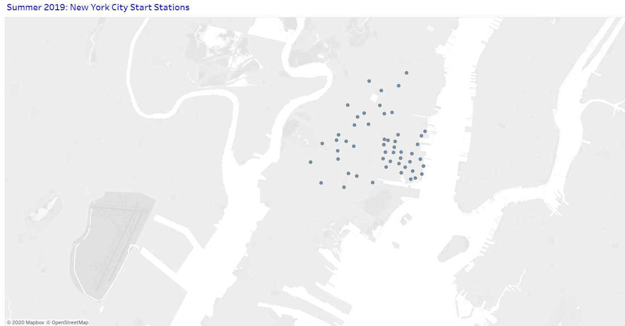
City Official Map

Slide 9
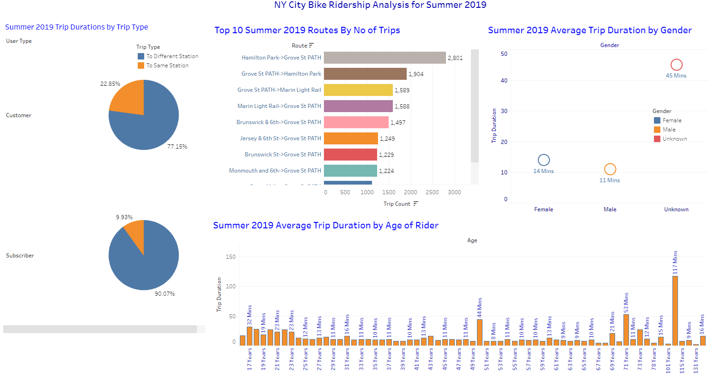
Dashboard

